Slide 1

Project Title – Air BNB Hotel Booking Analysis
Chitrang Potdar
INTERNSHIP_17546440516895be537820f

Slide 2

PROBLEM STATEMENT
Despite Airbnb’s rapid growth as a leading platform for short-term rentals, hosts and guests often face challenges in optimizing booking experiences. Hosts struggle to determine effective pricing strategies and understand guest preferences, while guests seek better value and satisfaction. There is a need to analyze booking patterns, pricing trends, guest behavior, and host performance to identify the key factors influencing successful bookings and positive guest experiences.

Slide 3
Project Description
This project focuses on analyzing Airbnb hotel booking data to uncover meaningful insights that can improve decision-making for hosts and enhance the overall guest experience. With the growing popularity of Airbnb as a global accommodation platform, it becomes essential to understand the factors that drive successful bookings, guest satisfaction, and host performance. The project involves collecting and exploring Airbnb booking datasets, followed by performing data cleaning, preprocessing, and visualization. Using Python and popular data analysis libraries, we examine patterns in booking behaviors, pricing strategies, seasonal trends, guest preferences, and host ratings. Through this analysis, we aim to:
Identify key factors influencing high booking rates and positive reviews.
Highlight pricing and availability strategies that improve occupancy.
Explore guest demographics and preferences that impact booking choices.
Provide actionable insights for hosts to optimize their listings.
By leveraging data-driven insights, this project contributes to better pricing strategies for hosts, improved guest satisfaction, and enhanced decision-making for the Airbnb platform.

Slide 4

WHO ARE THE END USERS?
Hosts (Property Owners/Managers)
Optimize pricing and occupancy
Improve guest experience & ratings
Guests (Travelers/Customers)
Find better value & comfort
Enjoy smoother booking experience
Airbnb Platform/Business Team
Enhance platform efficiency
Improve customer satisfaction & retention

Slide 5

Technology Used
Programming Language:
Python
Libraries for Data Analysis & Visualization:
Pandas → Data cleaning & manipulation
NumPy → Numerical computing
Matplotlib → Data visualization
Seaborn → Advanced statistical plots
Tools/Environment:
Jupyter Notebook / Google Colab
Excel/CSV for dataset handling

Slide 6
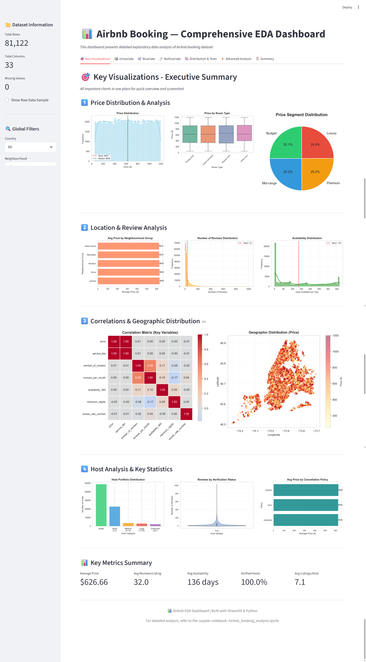
RESULTS1

Slide 7
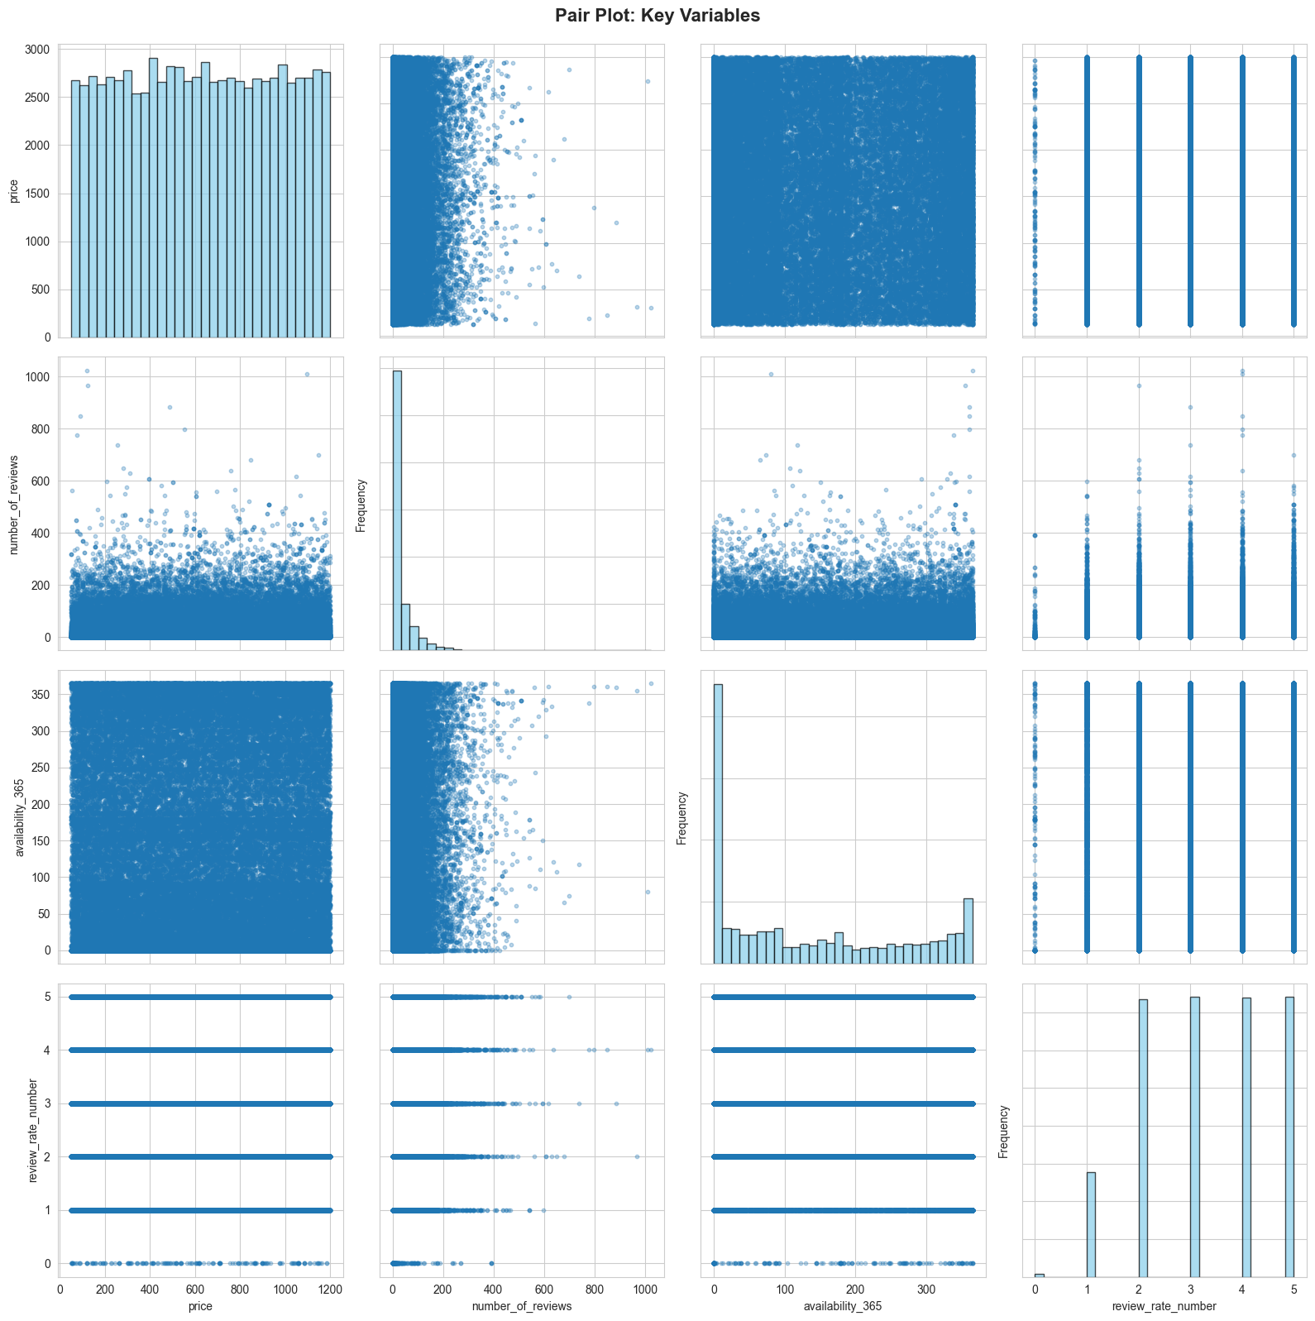
RESULTS2

Slide 8
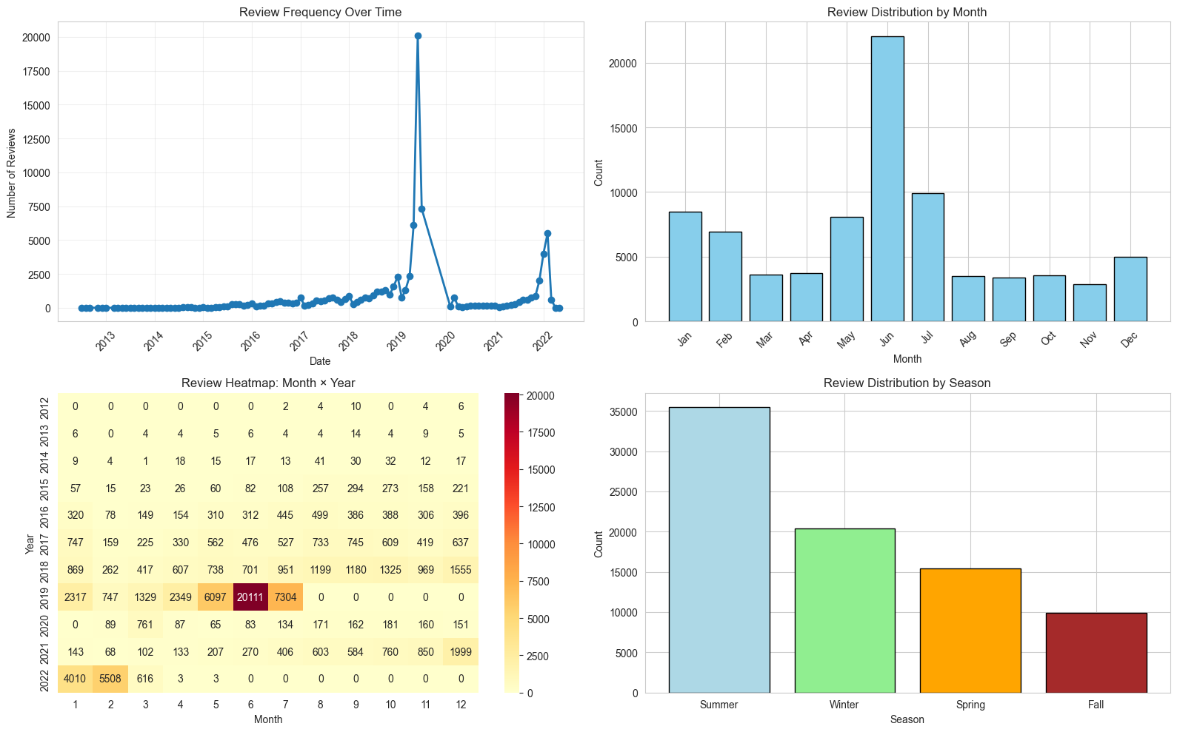
RESULTS3

Slide 9
GitHub repository
https://github.com/Dev-Chitrang/VOIS_AICTE_Oct2025_ChitrangPotdar
Demo Link

Slide 10
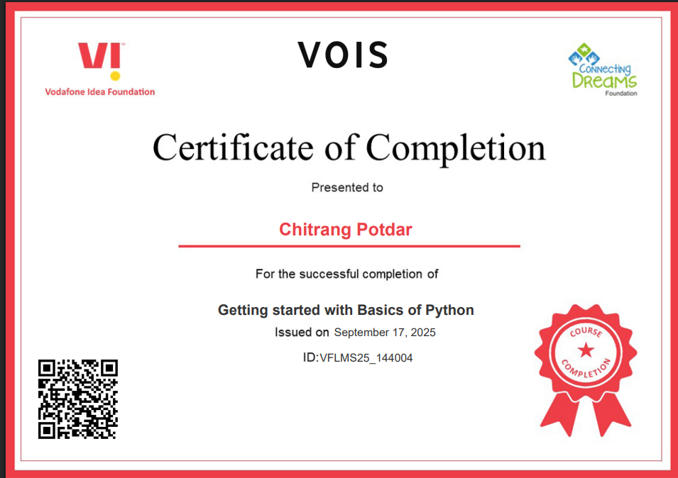
Getting started with Basics of Python Certificate

Slide 11
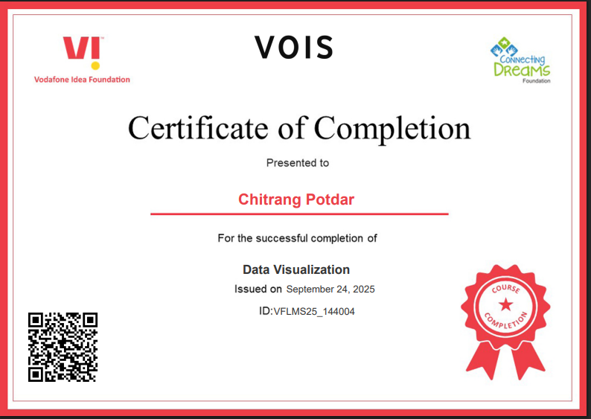
Data Visualization Certificate

Slide 12
Thank you

